Slide 1

Digital Image Processing
Chapter8: Segmentation
Dr. Mohammad Javad Parseh
Jahrom University
Department of Computer Engineering and Information Technology
October 2024

Slide 2
Introduction
Segmentation is the process of separating an image into multiple logical regions. The regions can be defined as pixels sharing similar characteristics such as intensity, texture, etc.
There are many methods of segmentation. They can be classified as follows:
Histogram-based segmentation
Region-based segmentation
Edge segmentation
Differential equation-based methods
Contour methods
Graph partitioning methods
Model based segmentation
Clustering methods, etc.

Slide 3
Histogram-Based Segmentation
In the histogram-based method a threshold is determined by using the histogram of the image.
Each pixel in the image is compared with the threshold value. If the pixel intensity is less than the threshold value, then the corresponding pixel in the segmented image is assigned a value of zero.
If the pixel intensity is greater than the threshold value, then the corresponding pixel in the segmented image is assigned a value of one.

Slide 4
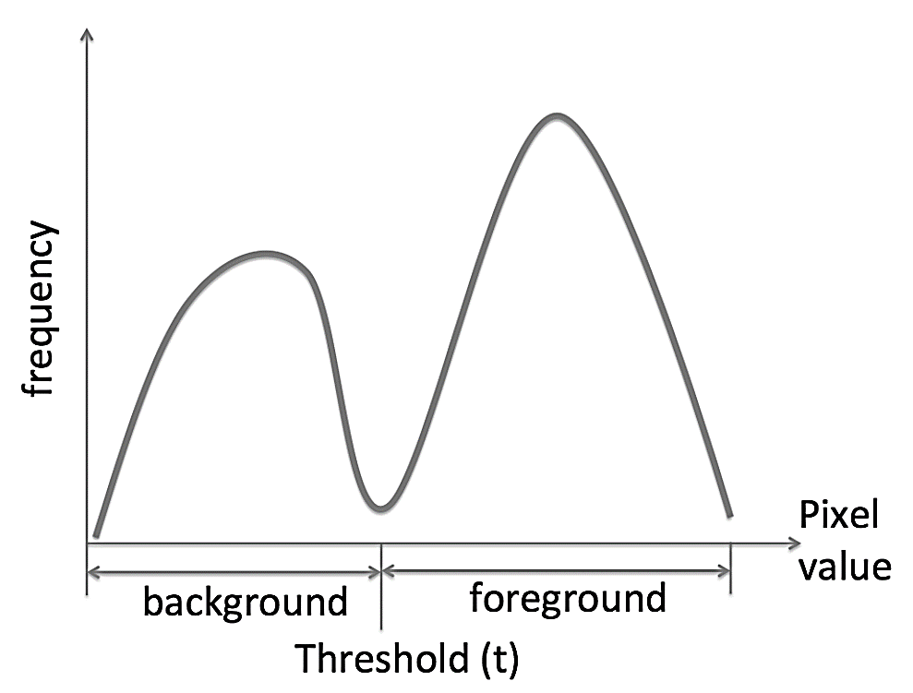
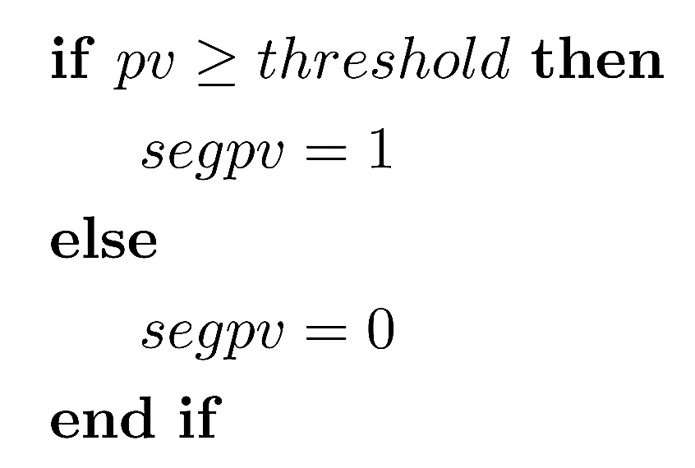
Histogram-Based Segmentation (cont.)

Slide 5
Histogram-Based Segmentation (cont.)
The various histogram-based methods differ in their techniques of determining the threshold.
Otsu’s method
Renyi entropy method
In images with a non-uniform background, a global threshold value from the histogram-based method might not be optimal. In such cases, local adaptive thresholding may be used.

Slide 6

Otsu’s Method
A bi-modal histogram is a type of histogram containing two distinct peaks separated by a valley.
Otsu’s method works best if the histogram of the image is bi-modal.
Otsu’s algorithm searches for a threshold value that maximizes the variance between the two groups foreground and background.

Slide 7
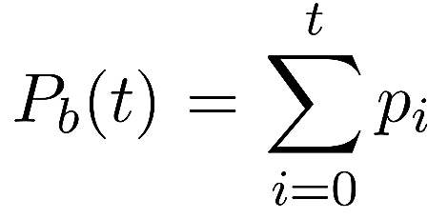
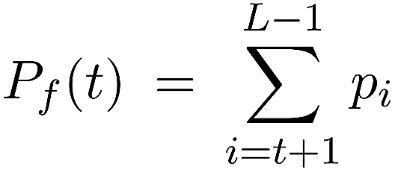
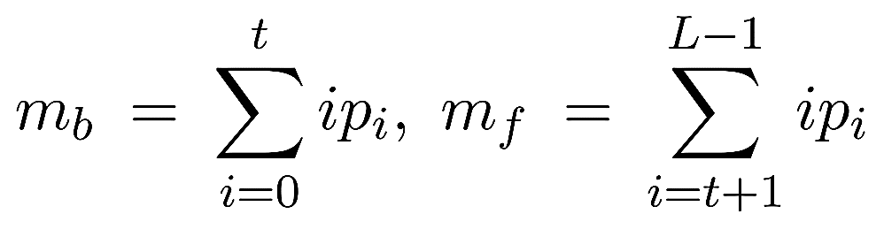
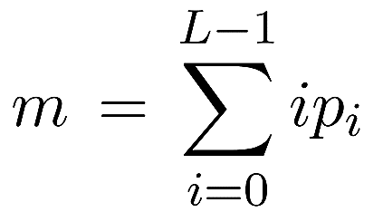
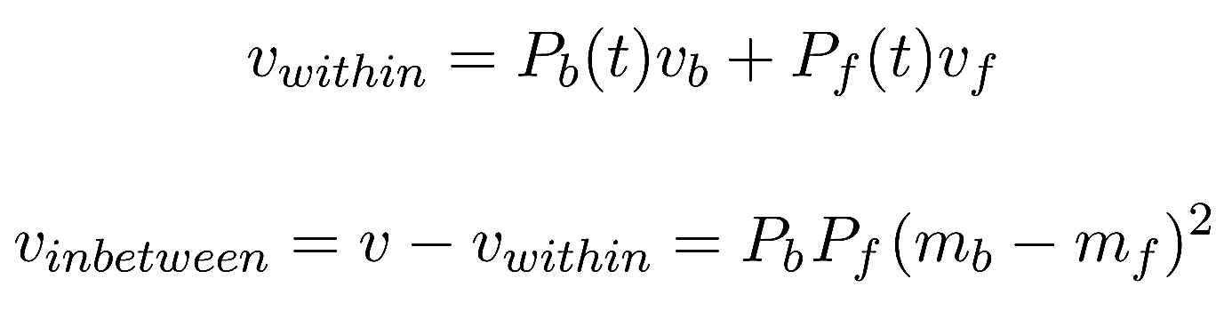
Otsu’s Method (cont.)

Slide 8
Otsu’s Method (cont.)
For different threshold values, this process of finding variance within the groups and variance between the groups is repeated.
The threshold value that maximizes the variance between the groups or minimizes the variance within the group is considered Otsu’s threshold.
In the case of a color image, since there are three channels, Red, Green, and Blue, a different threshold value for each channel is calculated.

Slide 9
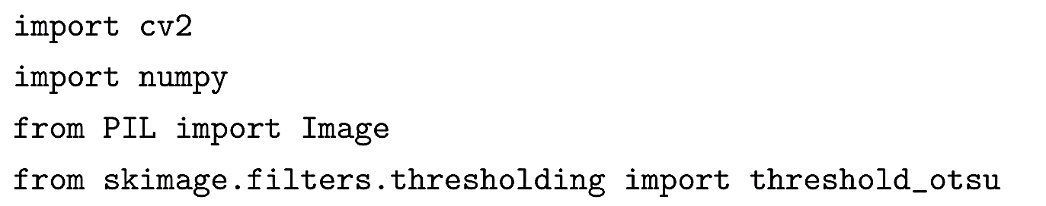
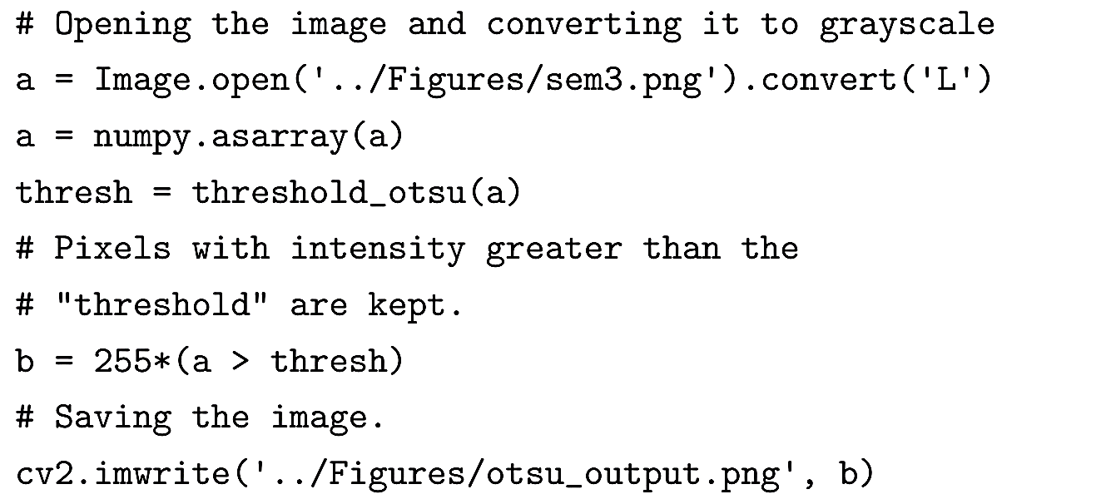
Otsu’s Method (cont.)

Slide 10
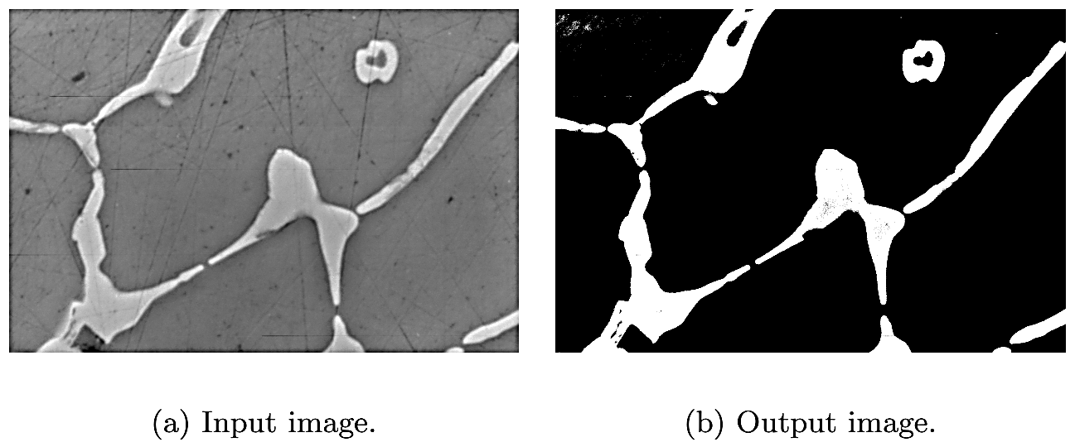
Otsu’s Method (cont.)

Slide 11
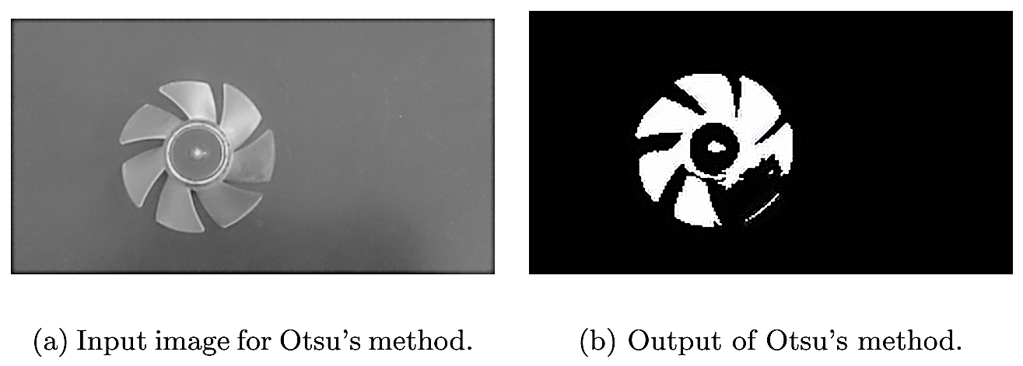
Otsu’s Method (cont.)

Slide 12
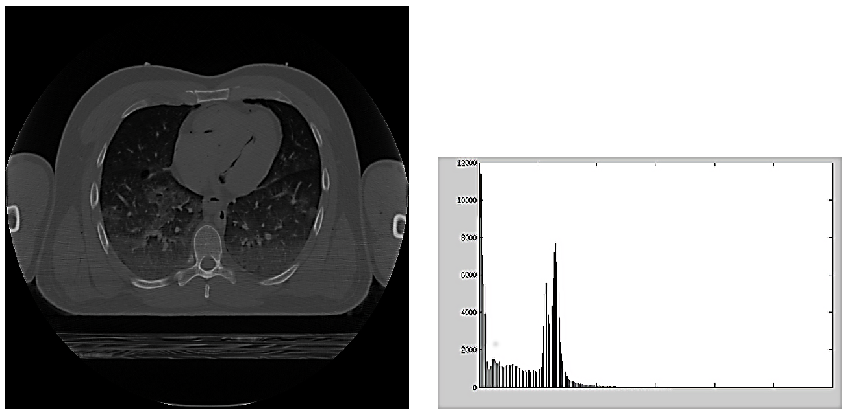
Renyi Entropy
Renyi entropy-based segmentation is very useful when the object of interest is small compared to the whole image i.e., the threshold is at the right tail of the histogram.

Slide 13
Renyi Entropy (cont.)
In information theory and image processing, entropy quantifies the uncertainty or randomness of a variable.
The concept of entropy was first introduced by Claude E. Shannon in his 1948 paper “Mathematical Theory of Communication”.
In information theory and also in image processing, entropy is measured in bits where each pixel value is considered as an independent random variable.

Slide 14
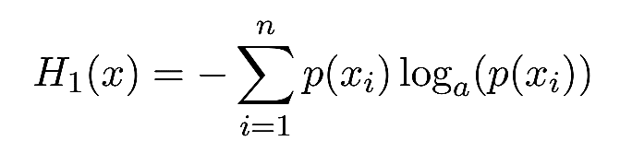
Renyi Entropy (cont.)
Shannon entropy is given by:
where x_{i} is the random variable with i = 1, 2, …, n and p(x_{i}) is the probability of the random variable x_{i} and the base a can be 2, e, or 10.

Slide 15
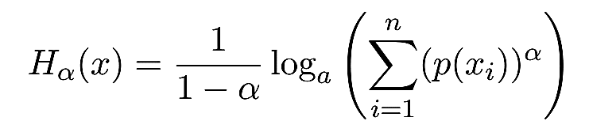
Renyi Entropy (cont.)
Alfred Renyi, a Hungarian mathematician, introduced Renyi entropy in his paper in 1961.
Renyi entropy is a generalization of Shannon entropy and many other entropies and is given by the following equation:
where x_{i} is the random variable with i = 1, 2, …, n and p(x_{i}) is the probability of the random variable x_{i} and the base a can be 2, e or 10.

Slide 16
Renyi Entropy (cont.)
The normalized histogram of the image is used as an independent random variable to determine the threshold.
This is the probability distribution function (pdf) of the histogram. The Renyi entropy can then be calculated for this pdf.
The Renyi entropy is calculated for all pixels below (background entropy) and above (foreground entropy) the threshold.
The total entropy is calculated as the sum of background entropy and foreground entropy for each pixel value in the pdf as a threshold.
The total entropy has one absolute maximum. The threshold value corresponding to that absolute maximum is the threshold (t) for segmentation.

Slide 17
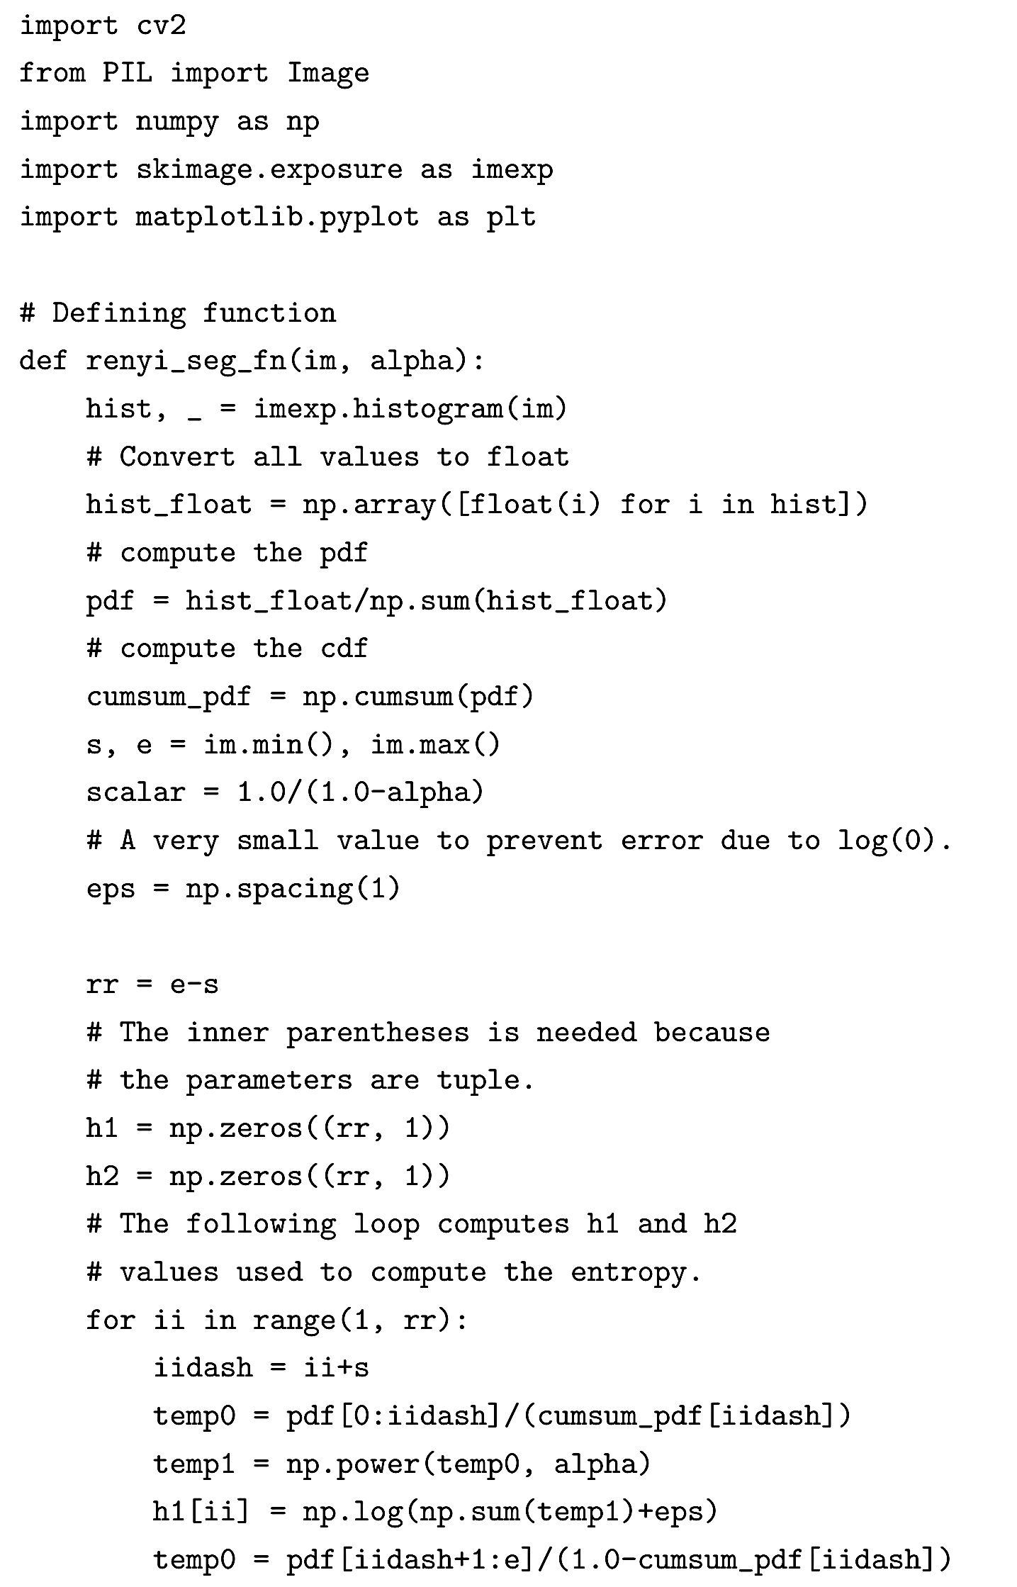
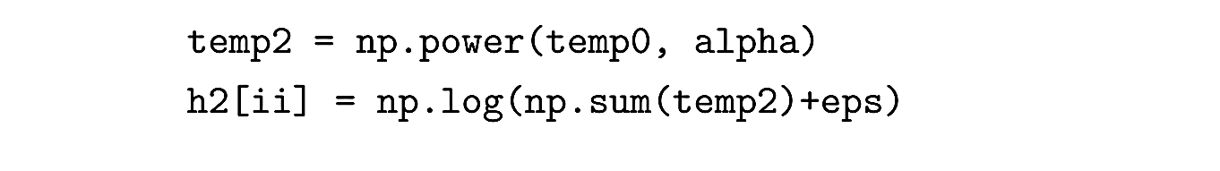
Renyi Entropy (cont.)

Slide 18

Renyi Entropy (cont.)

Slide 19
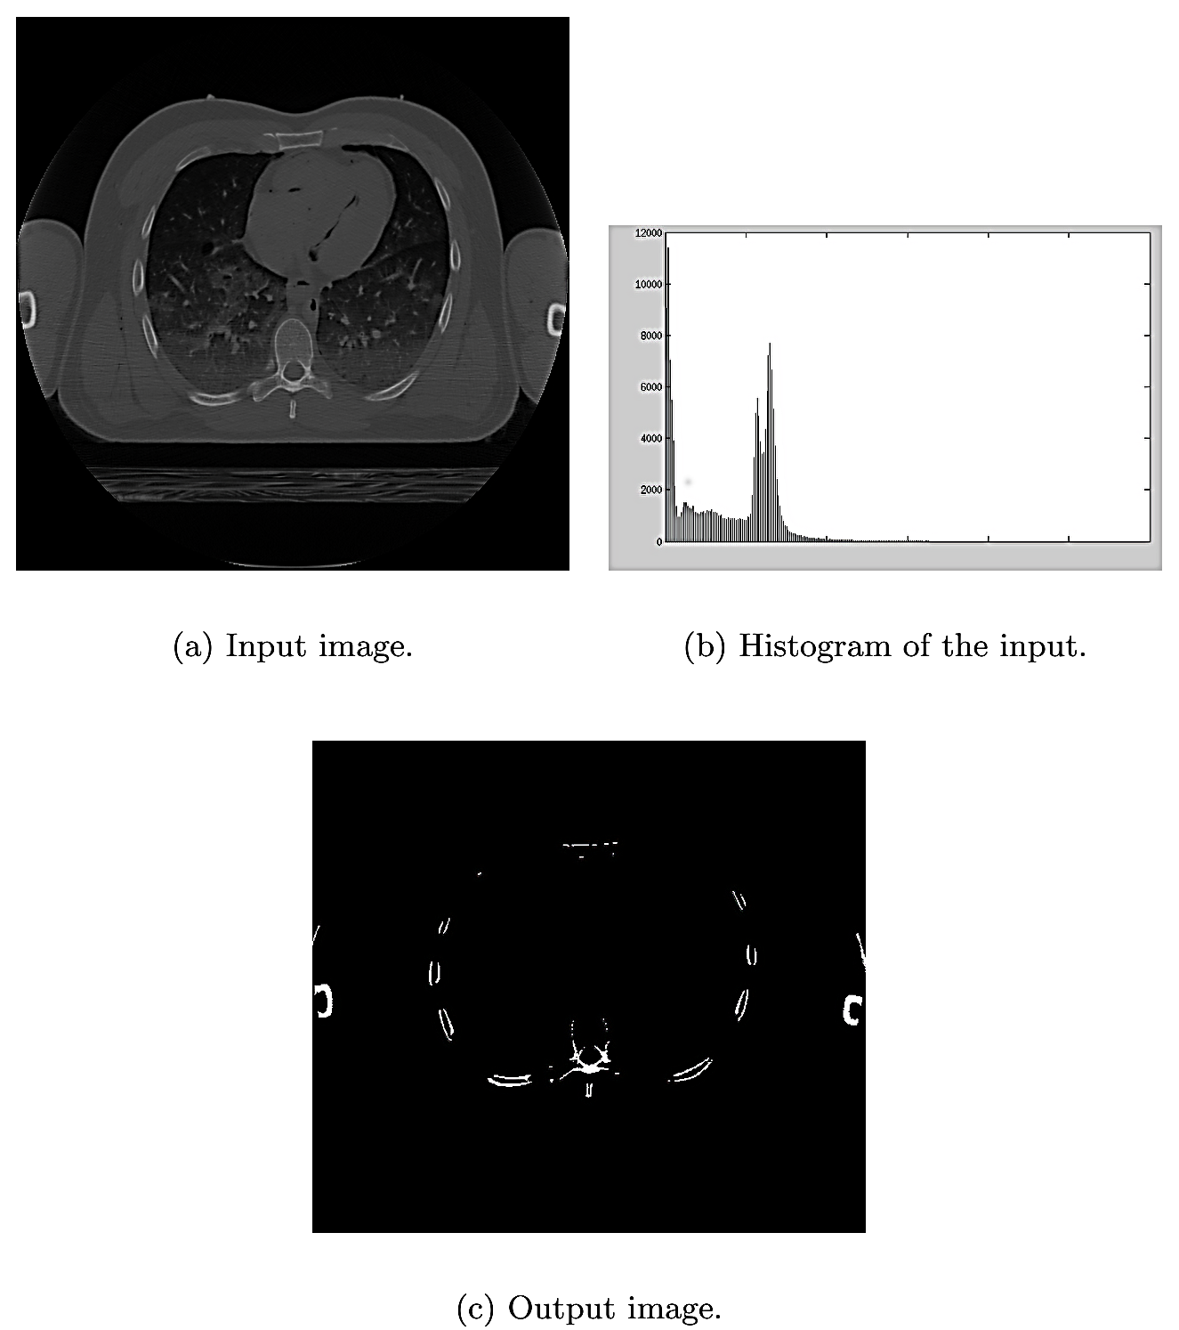
Renyi Entropy (cont.)

Slide 20
Adaptive Thresholding
In adaptive thresholding, the image is first divided into many sub-images.
The threshold value for each sub-image is computed and is used to segment the sub-image.
The threshold value for the sub-image can be computed using the mean or median or Gaussian methods.
A custom formula can also be used to compute the threshold
we can use an average of maximum and minimum pixel values in the sub-image.
Any of the histogram-based segmentation methods can be converted into an adaptive thresholding method.

Slide 21
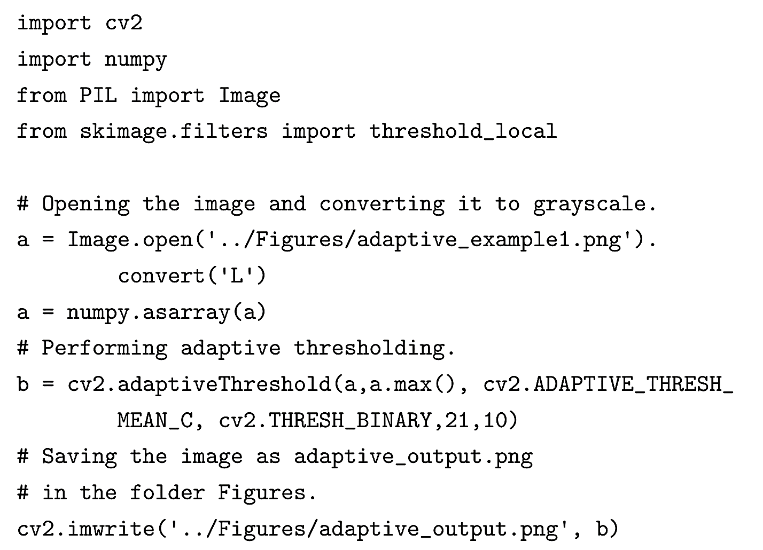
Adaptive Thresholding (cont.)

Slide 22
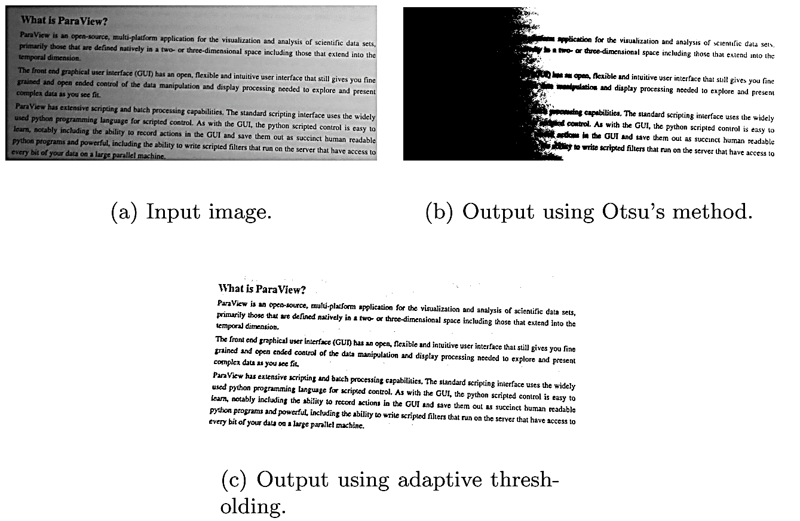
Adaptive Thresholding (cont.)

Slide 23
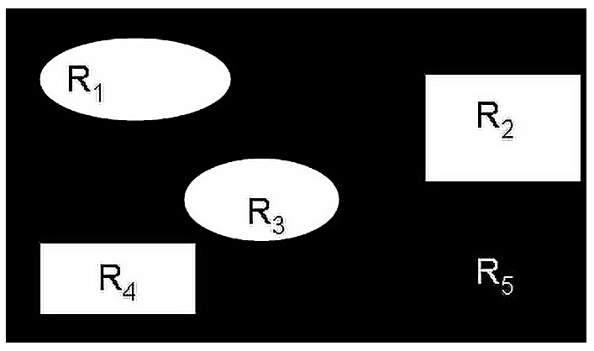
Region-Based Segmentation
A region is a group or collection of pixels that have similar properties sharing the same characteristics. The characteristics can be pixel intensities, texture, or some other physical feature.
Previously, we have used a threshold obtained from a histogram to segment the image. In this section we demonstrate techniques that are based on the Region of Interest (ROI).

Slide 24
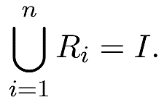
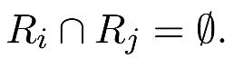
Region-Based Segmentation (cont.)
We can now formulate basic rules that govern the region-based segmentation:
All the regions combined should equal the image,
Each region, R_{i} is connected for i = 1 to n.
No two regions overlap,

Slide 25
Region-Based Segmentation (cont.)
To segment the regions, we need some a priori information. This a priori information is the seed pixels, pixels that are part of the foreground.
The seed pixels grow by considering the pixels in their neighborhood that have similar properties.
This process connects all the pixels in a region with similar properties. The region-growing process will terminate when there are no more pixels to add that share the same characteristics of the region.
It might not always be possible to have a priori knowledge of the seed pixels.

Slide 26
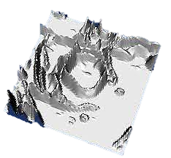
Watershed Segmentation
The grayscale values of the image represent the peaks and valleys of the topographic terrain of the image.
The lowest valley in an object is the absolute minimum. The highest grayscale value corresponds to the highest point in the terrain.

Slide 27
Watershed Segmentation (cont.)
All the points in a region where, if a drop of water was placed will settle to the absolute minimum are known as the catchment basin of that minimum or watershed.
If water is supplied at a uniform rate from the absolute minimum in an object, as water fills up the object, at some point water will overflow into other objects.
Dams are constructed to stop water from overflowing into other objects/regions.
These dams are the watershed segmentation lines. The watershed segmentation lines are edges that separate one object from another.

Slide 28
Watershed Segmentation (cont.)
Meyer’s algorithm for watershed segmentation:
The original input image and the marker image are given as inputs.
For each region in the marker image, its neighboring pixels are placed in a ranked list according to their gray levels.
If the pixels in the labeled region have the same gray level as the pixel with the highest rank, then the pixel is included in the labeled region.
The above step is repeated until there are no elements in the list.

Slide 29
Watershed Segmentation (cont.)
Prior to performing watershed segmentation, the image has to be preprocessed to obtain a marker image.
Since the water is supplied from catchment basins, these basin points are guaranteed foreground pixels. The guaranteed foreground pixel image is known as the marker image.

Slide 30
Watershed Segmentation (cont.)
The preprocessing operations that should be performed before watershed segmentation are as follows:
Foreground pixels are segmented from the background pixels using thresholding method.
Erosion is performed to obtain foreground pixels only. Erosion is a morphological operation in which the background pixels grow and foreground pixels shrink.
Distance transform creates an image where every pixel contains the value of the distance between itself and the nearest background pixel. Thresholding is done to obtain the pixels that are farthest away from the background pixels and are guaranteed to be foreground pixels.
All the connected pixels in a region are given a value in the process known as labeling. The labeled image is used as a marker image.

Slide 31
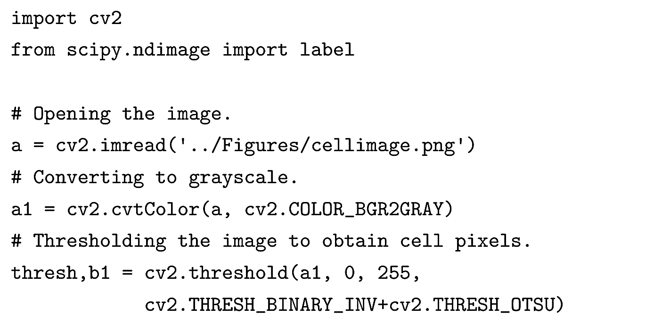
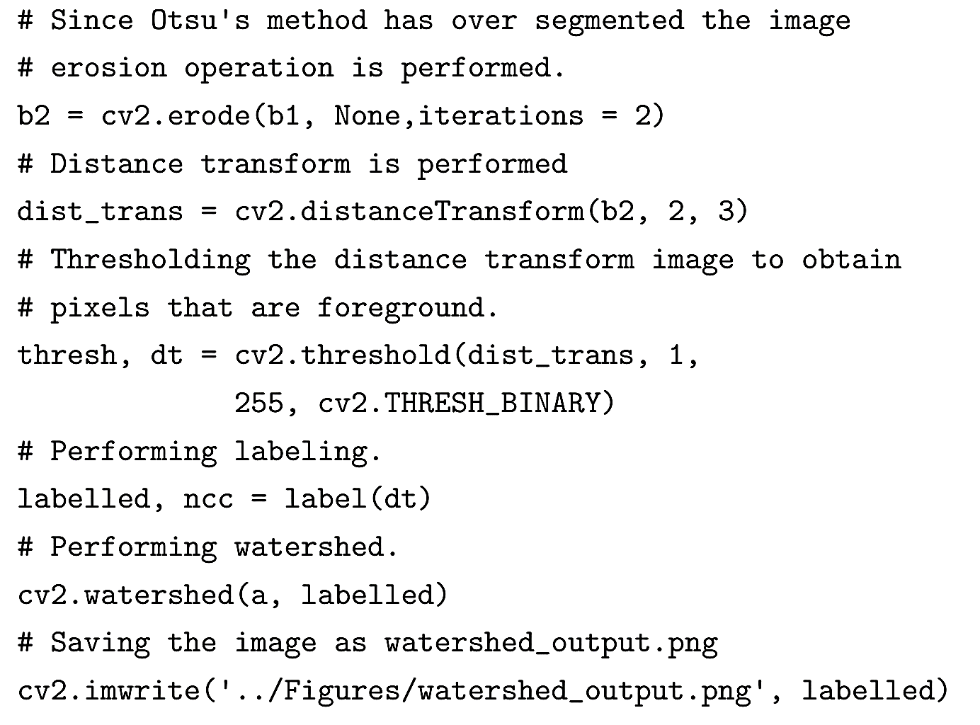
Watershed Segmentation (cont.)

Slide 32
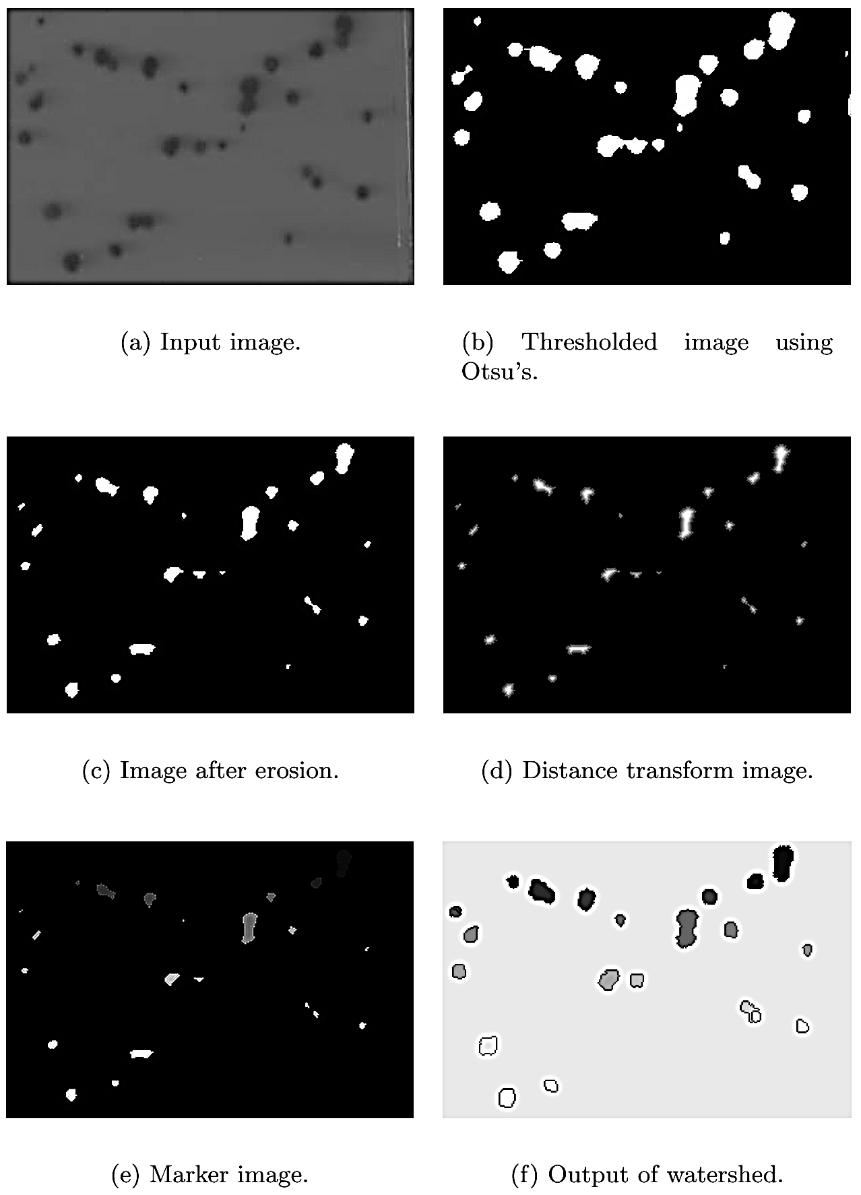
Watershed Segmentation (cont.)

